Slide 1
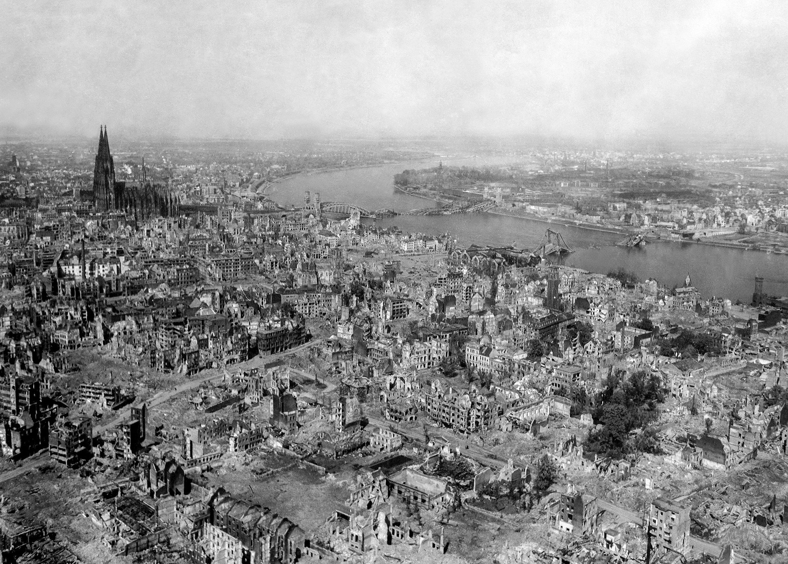
WWII:
A Day In History
A visual representation by:
Ibet Hernandez
Andrew Zamora
&
Vanessa Simpson

Slide 2
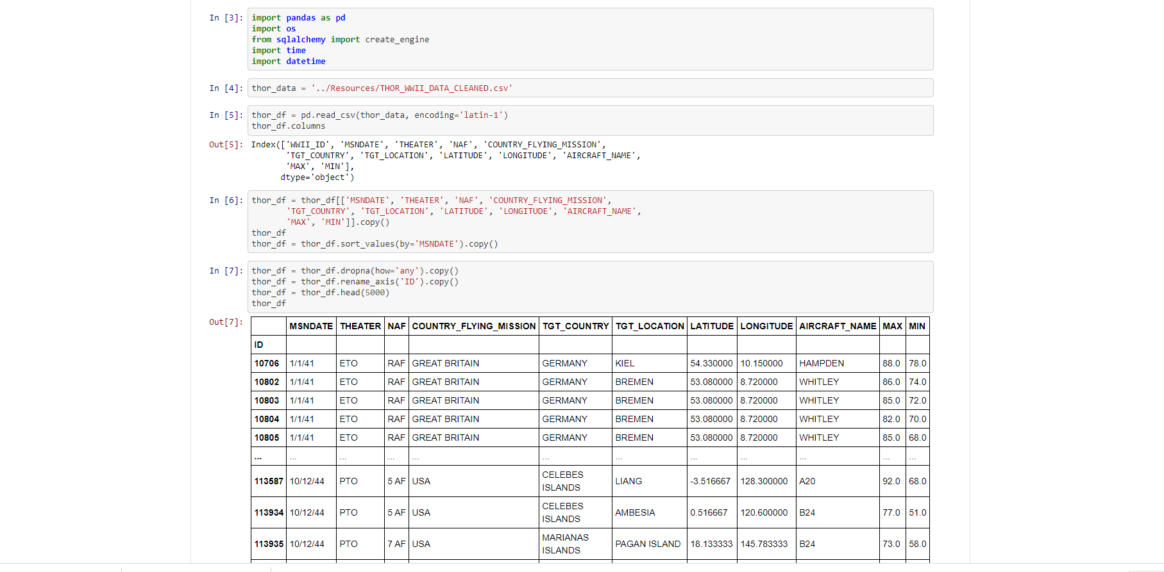
Data Cleanup
We worked together to analyze and pair down over 120,000 rows of data from 2 separate CSVs and parsed the information into 1 table of data.

Slide 3
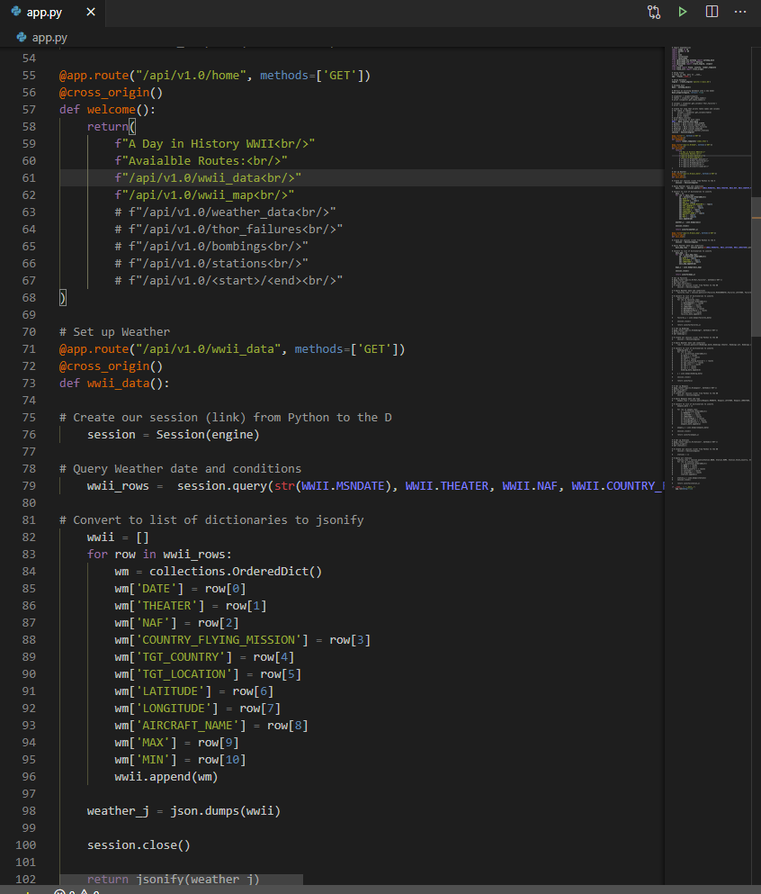
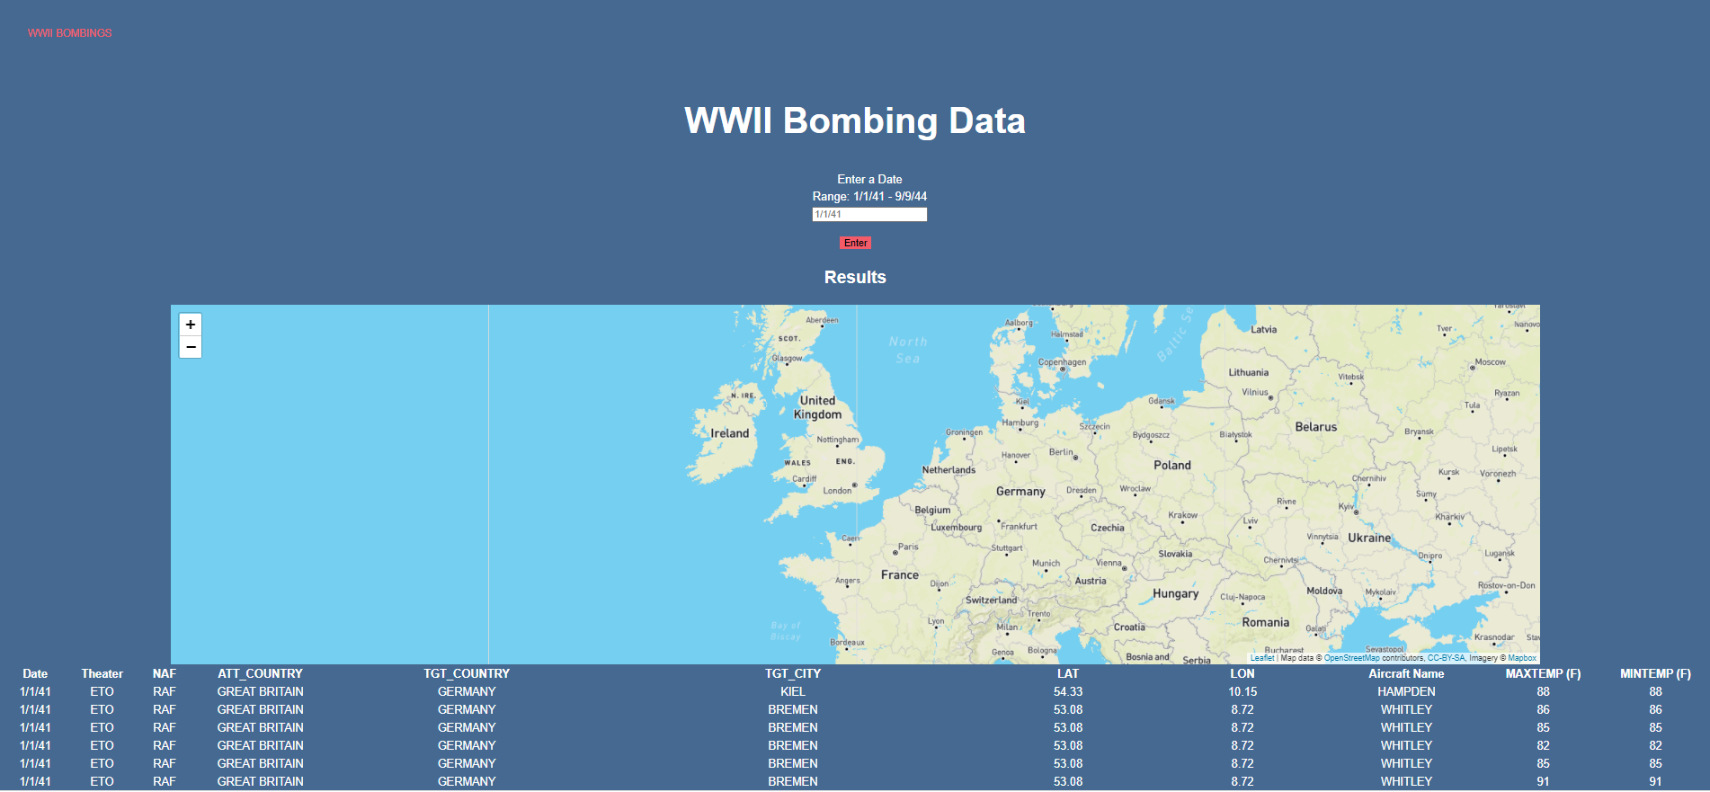
We then worked to build a dashboard that would show weather and bombing data when a specific date was entered.

Slide 4
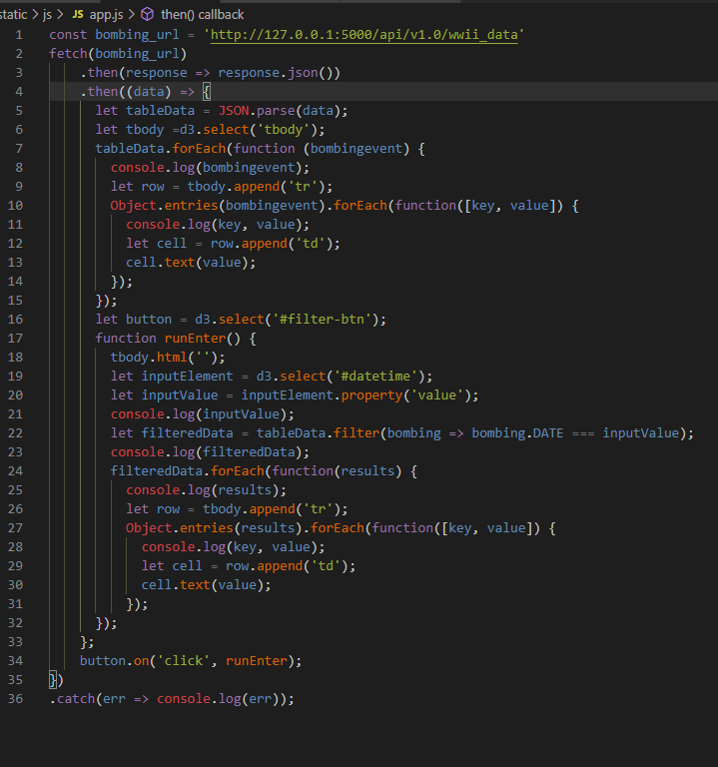
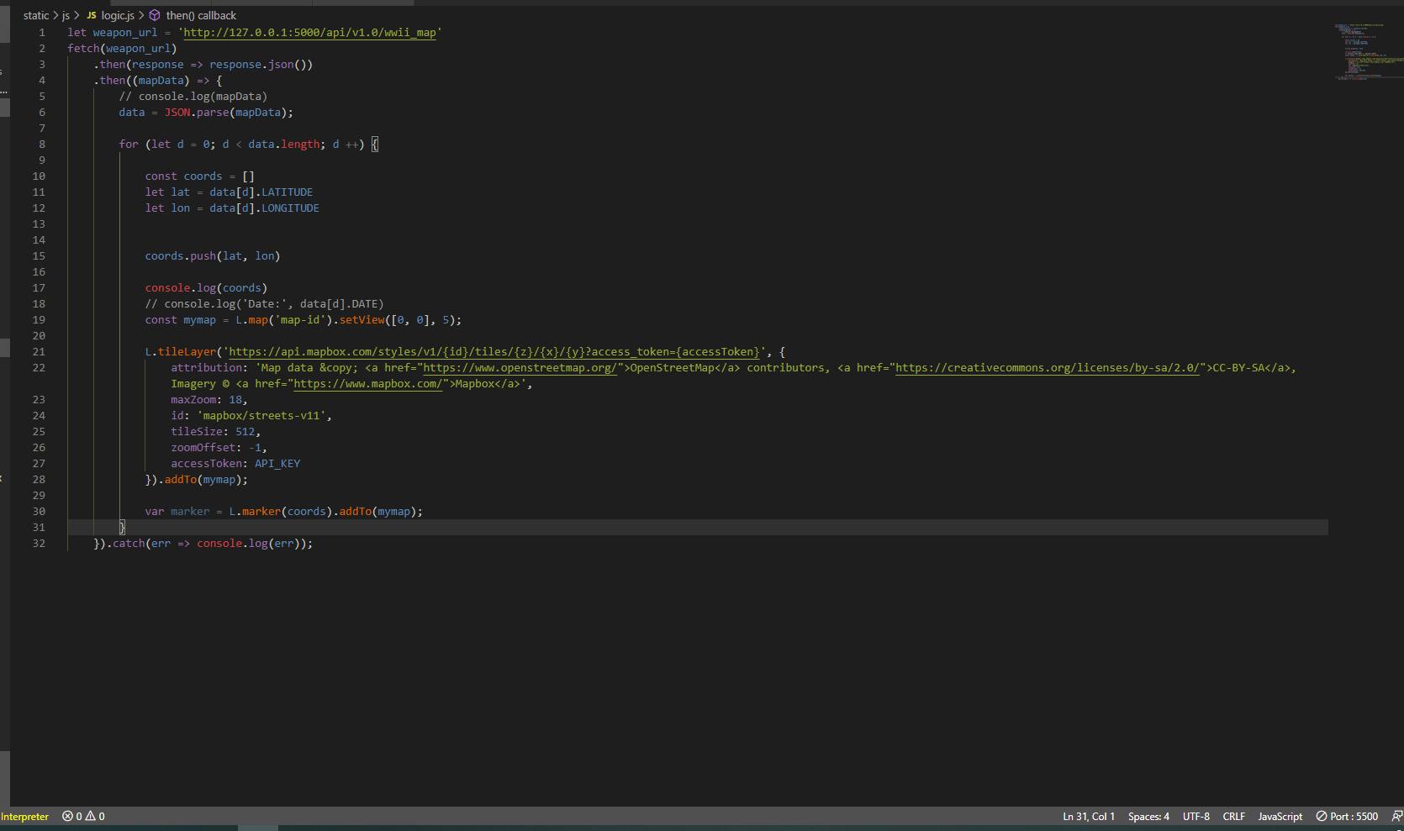
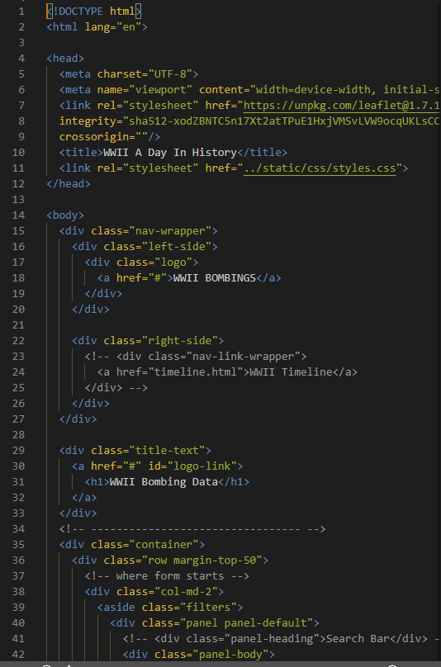
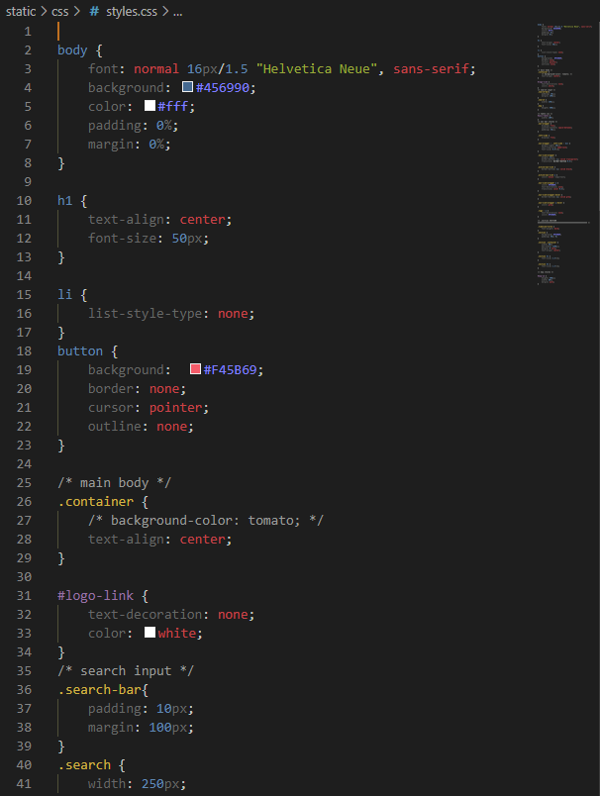
Using leaflet.js and D3 we created the map and table shown on our dashboard
And added CSS and HTML elements to style our page

